Slide 1

Thinking in ETL
Logo PIMS
01
Logo Cierres
02
Logo otro app
03
By: William Andrés Pinilla

Slide 2

The 7 biggest benefits of ETL tools

Slide 3

New user requests
I have a specific issue
Process fail
KEEP CALM!
I have a idea to solve them
It doesn't work the app
Architect
Users

Slide 4
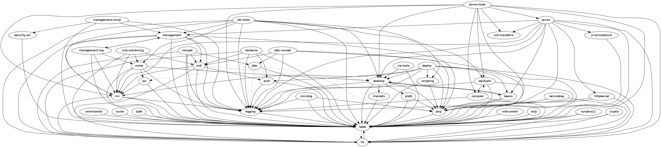

Systems Gathering
High Coupling & Low Cohesion
Business users take
technology decisions
There isn't documentation
Regular solutions with
overrated tools
That sucks!!!
A few comments
in the code
Short-term design

Slide 5


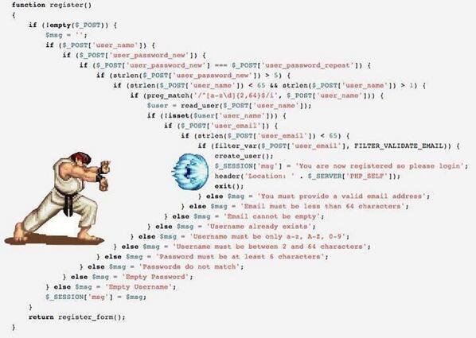
First Review
An excellent code doesn't need comment but when you see that
A huge Inspection of code to understand the process
That sucks!!!
Increase the time to design a new solution !

Slide 6

The brain processes better an image...Think in data flows through sketch
1. View Flow
Notes:
The single greatest advantage of an ETL tool is that it provides a visual flow of the system’s logic (if the tool is flow based). Each ETL tool presents these flows differently, but even the least-appealing of these ETL tools compare favorably to custom systems consisting of plain SQL, stored procedures and system scripts, and perhaps a handful of other technologies.

Slide 7


Complex structures don't mean the best solution...
2. Structured system design
Notes:
ETL tools are designed for the specific problem of data integration: populating a data warehouse or integrating data from multiple sources, or even just moving the data. With maintainability and extensibility in mind, they provide in many cases a metadata-driven structure to the developers. This is particularly a big advantage for teams building their first data warehouse.

Slide 8
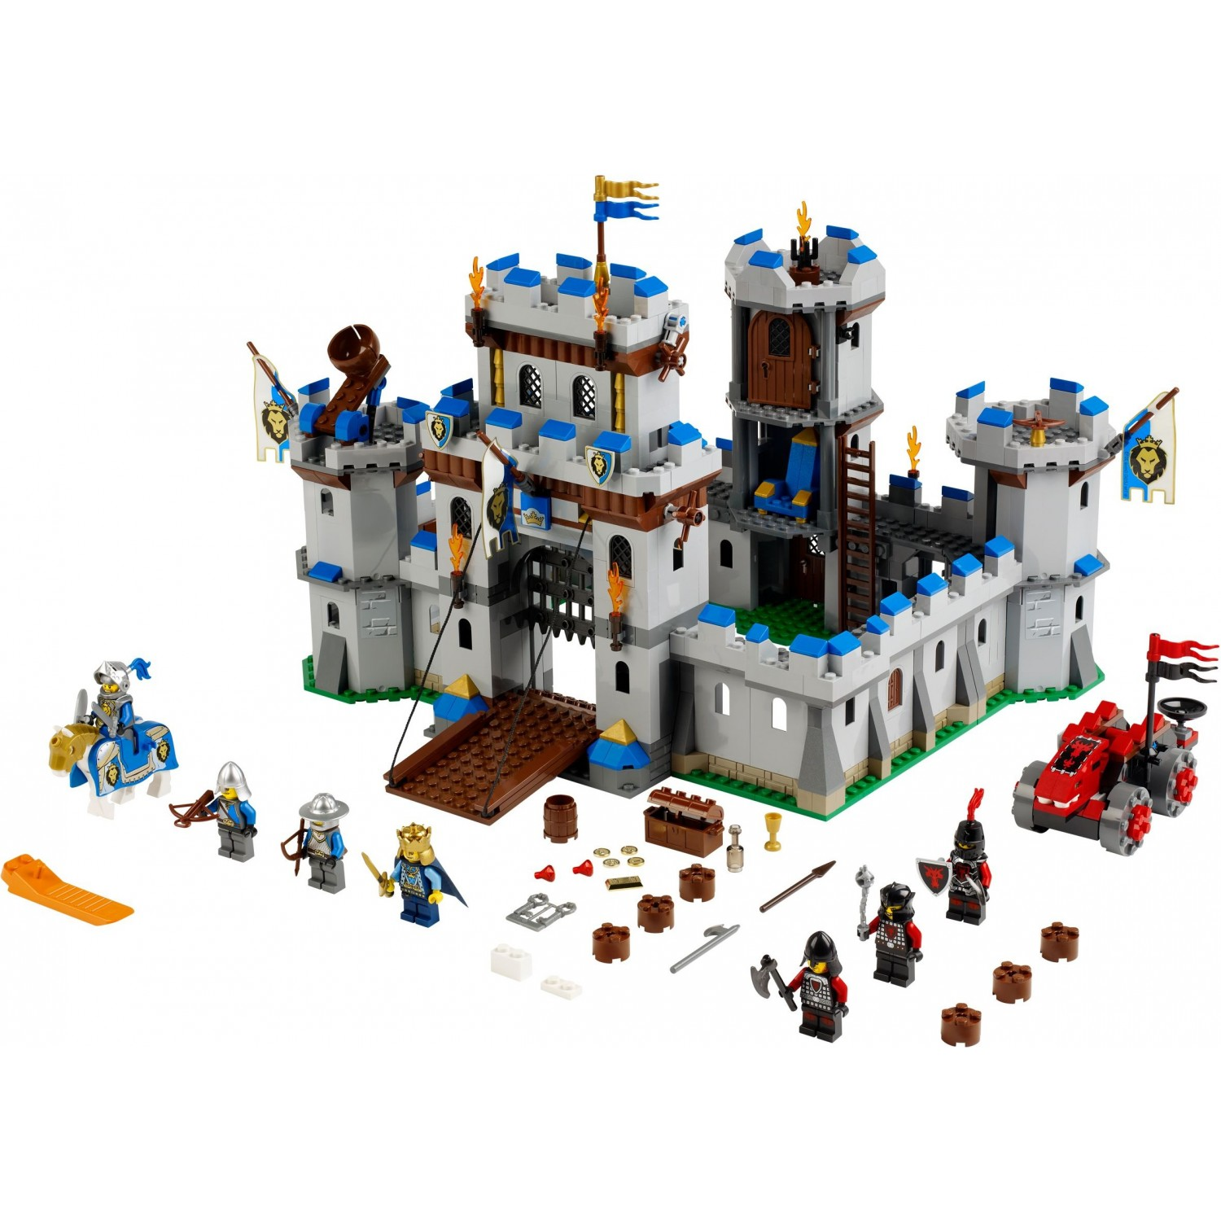
Simple structure but it has better foundations to build the same...
2. Structured system design
Notes:
Sp are power tools but it shouldn't use for everything, avoid build somethin that trigger a cascade effect... Think in modularity

Slide 9

Perform a new change is than easy as to assemble your own smartphone
2. Structured system design
Notes:
Sp are power tools but it shouldn't use for everything, avoid build somethin that trigger a cascade effect... Think in modularity

Slide 10

A new feature...A new challange...
3. Operational resilience
Notes:
Many of the home-grown data warehouses we have evaluated are rather fragile: they have many emergent operational problems. ETL tools provide functionality and standards for operating and monitoring the system in production. It is certainly possible to design and build a well instrumented hand-coded ETL application. Nonetheless, it’s easier for a data warehouse / business intelligence team to build on the features of an ETL tool to build a resilient ETL system.

Slide 11

Resilience fails should be easy as to return to other level to recover health... Remember: the traceability to identify likely bugs when you are designing components
3. Operational resilience
Notes:
Sp are power tools but it shouldn't use for everything, avoid build somethin that trigger a cascade effect... Think in modularity

Slide 12
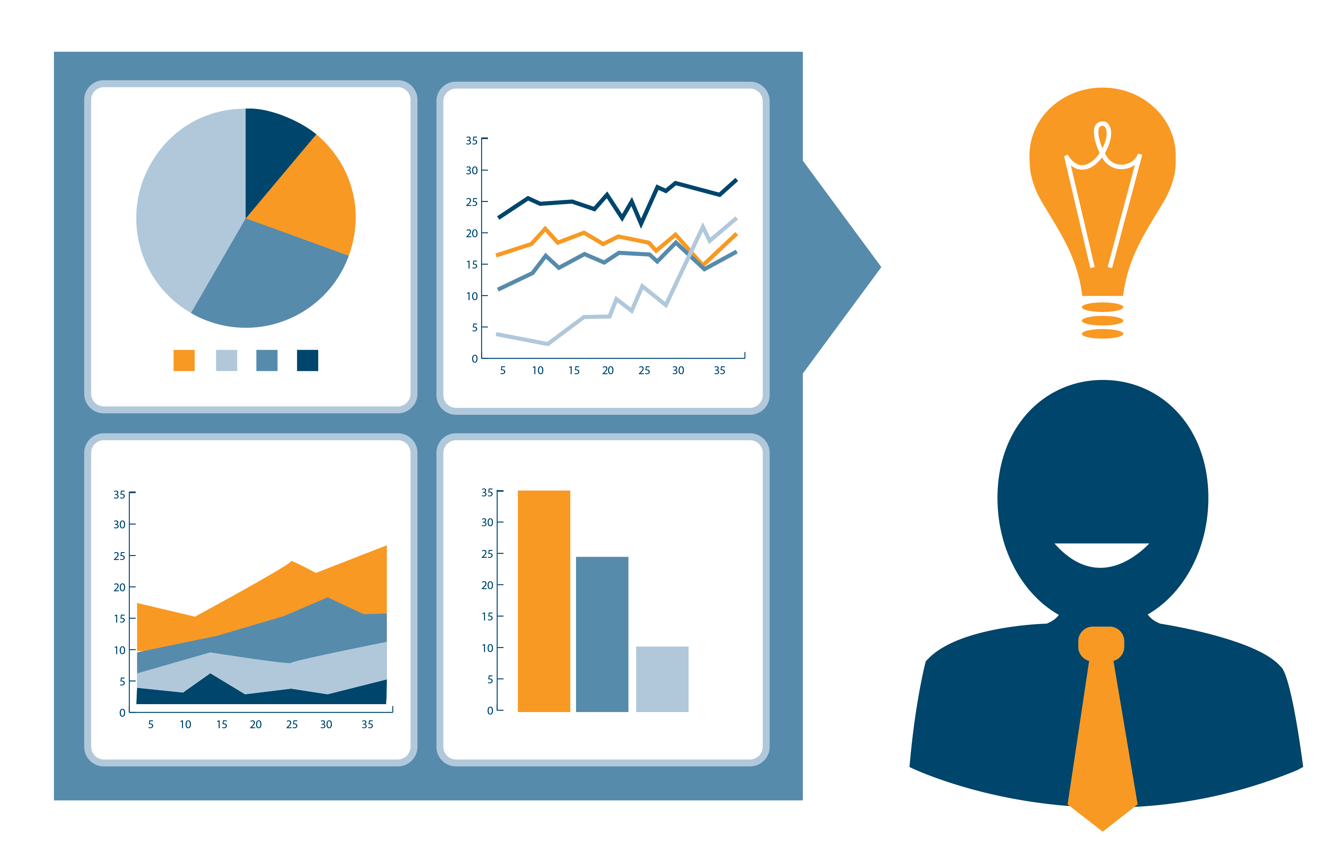
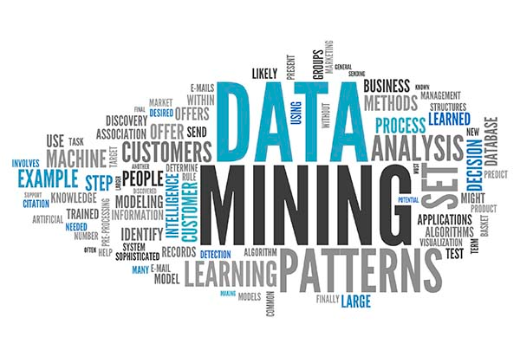
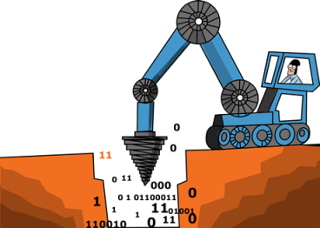
Advanced tools to across and transforms different data sources
4. Advanced data profiling and cleansing
Notes:
Most data warehouses are structurally complex, with many data sources and targets. At the same time, requirements for transformation are often fairly simple, consisting primarily of lookups and substitutions. If you have a complex transformation requirement, for example if you need to de-duplicate your customer list, you should buy on additional module on top of the ETL solution (data profiling / data cleansing). At the very least, ETL tools provide a richer set of cleansing functions than are available in SQL. Download the ETL Tools& Data Integration Survey to see how the ETL tools compare on this aspects.

Slide 13
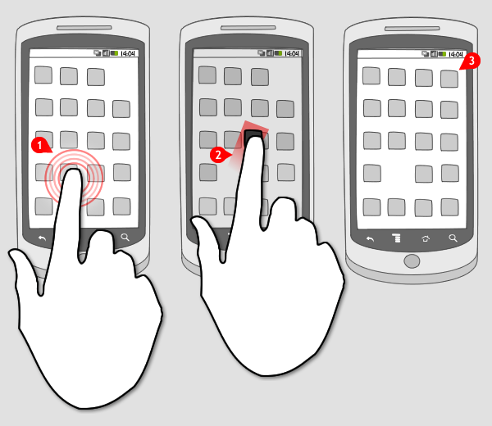
Well...you should keep the KISS philosophy
Keeping it simple stupid!
5. Drag and Drop is awesome
Notes:
Sp are power tools but it shouldn't use for everything, avoid build somethin that trigger a cascade effect... Think in modularity

Slide 14
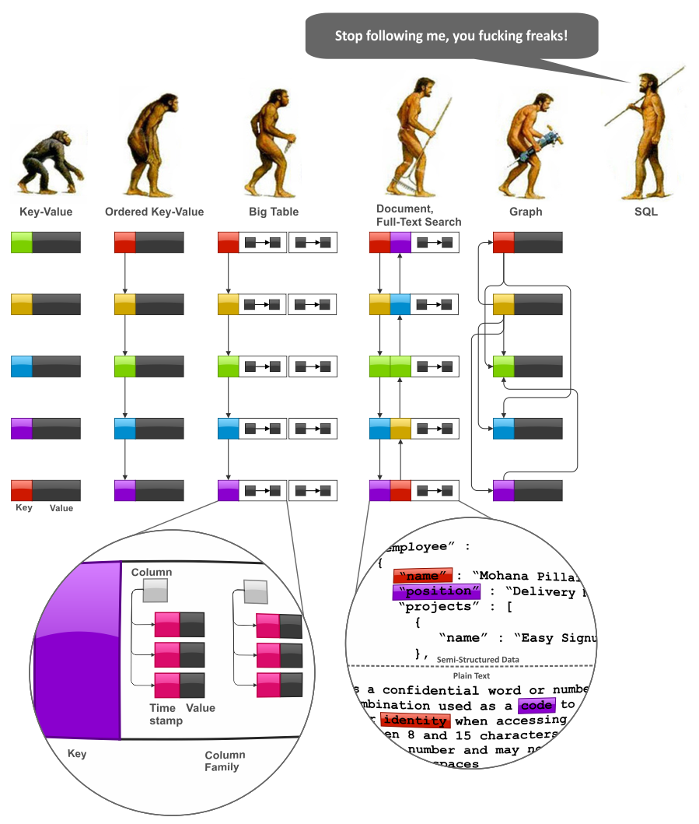
Stop following me, you fucking freaks!!!
6. Performance
Notes:
hace unos años la virtualización era lenta y ahora es uno de los pilares del cloud computing You might be surprised that performance is listed as one of the last under the advantages of the ETL tools. It’s possible to build a high-performance data warehouse whether you use an ETL tool or not. It’s also possible to build an absolute dog of an data warehouse whether you use an ETL tool or not. We’ve never been able to test whether an excellent hand-coded data warehouse outperforms an excellent tool-based data warehouse; we believe the answer is that it’s situational. But the structure imposed by an ETL platform makes it easier for an (novice) ETL developer to build a high-quality system. Furthermore many ETL tools provide performance enhancing technologies, such as Massively Parallel Processing, Symmetric Multi-Processing and Cluster Awareness.

Slide 15
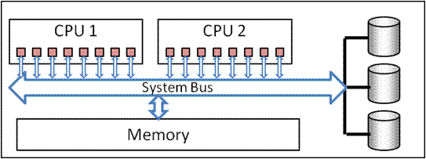
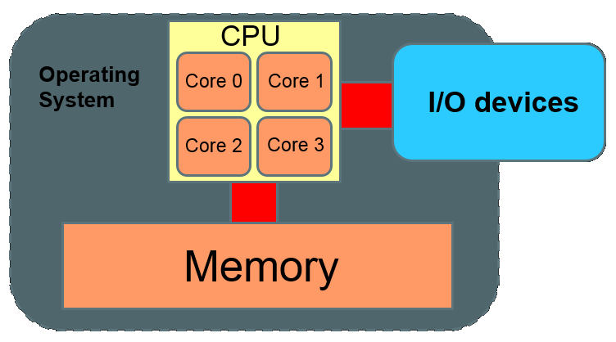
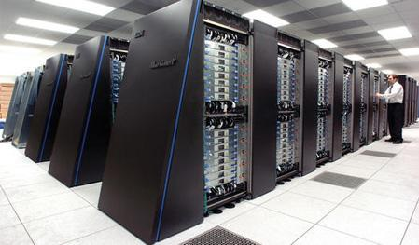
Massively Parallel Processing
Symmetric Multi-Processing
Cluster Awareness.
6. Performance
Notes:
We’ve never been able to test whether an excellent hand-coded data warehouse outperforms an excellent tool-based data warehouse; we believe the answer is that it’s situational. But
the structure imposed by an ETL platform makes it easier for an (novice) ETL developer to build a high-quality system.
Furthermore many ETL tools provide performance enhancing technologies, such as Massively Parallel Processing, Symmetric Multi-Processing and Cluster Awareness.

Slide 16
Massively Parallel Processing
Symmetric Multi-Processing
Cluster Awareness.
7.
Notes:
We’ve never been able to test whether an excellent hand-coded data warehouse outperforms an excellent tool-based data warehouse; we believe the answer is that it’s situational. But
the structure imposed by an ETL platform makes it easier for an (novice) ETL developer to build a high-quality system.
Furthermore many ETL tools provide performance enhancing technologies, such as Massively Parallel Processing, Symmetric Multi-Processing and Cluster Awareness.

Slide 17
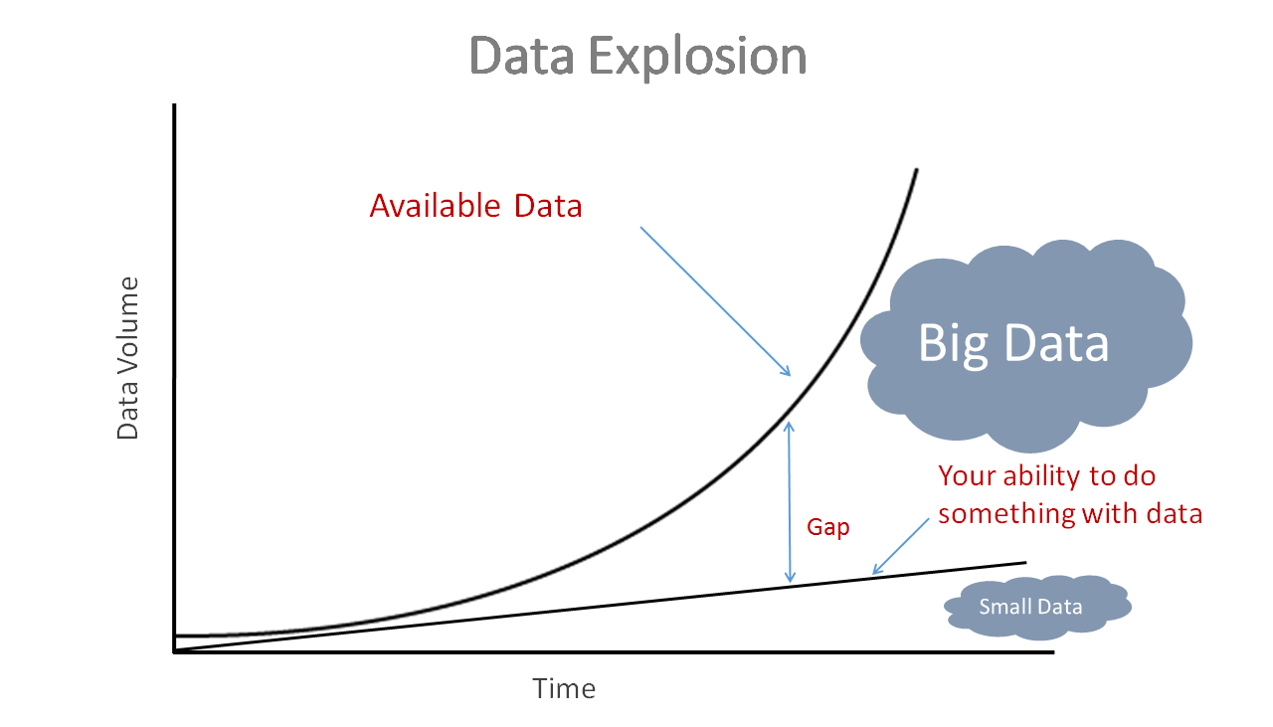
7. Big Data
Notes:
Cualquier crecimiento exponencial en la data ya sea de megas a teras ya considera como un insumo real para trabajar con big data

Slide 18
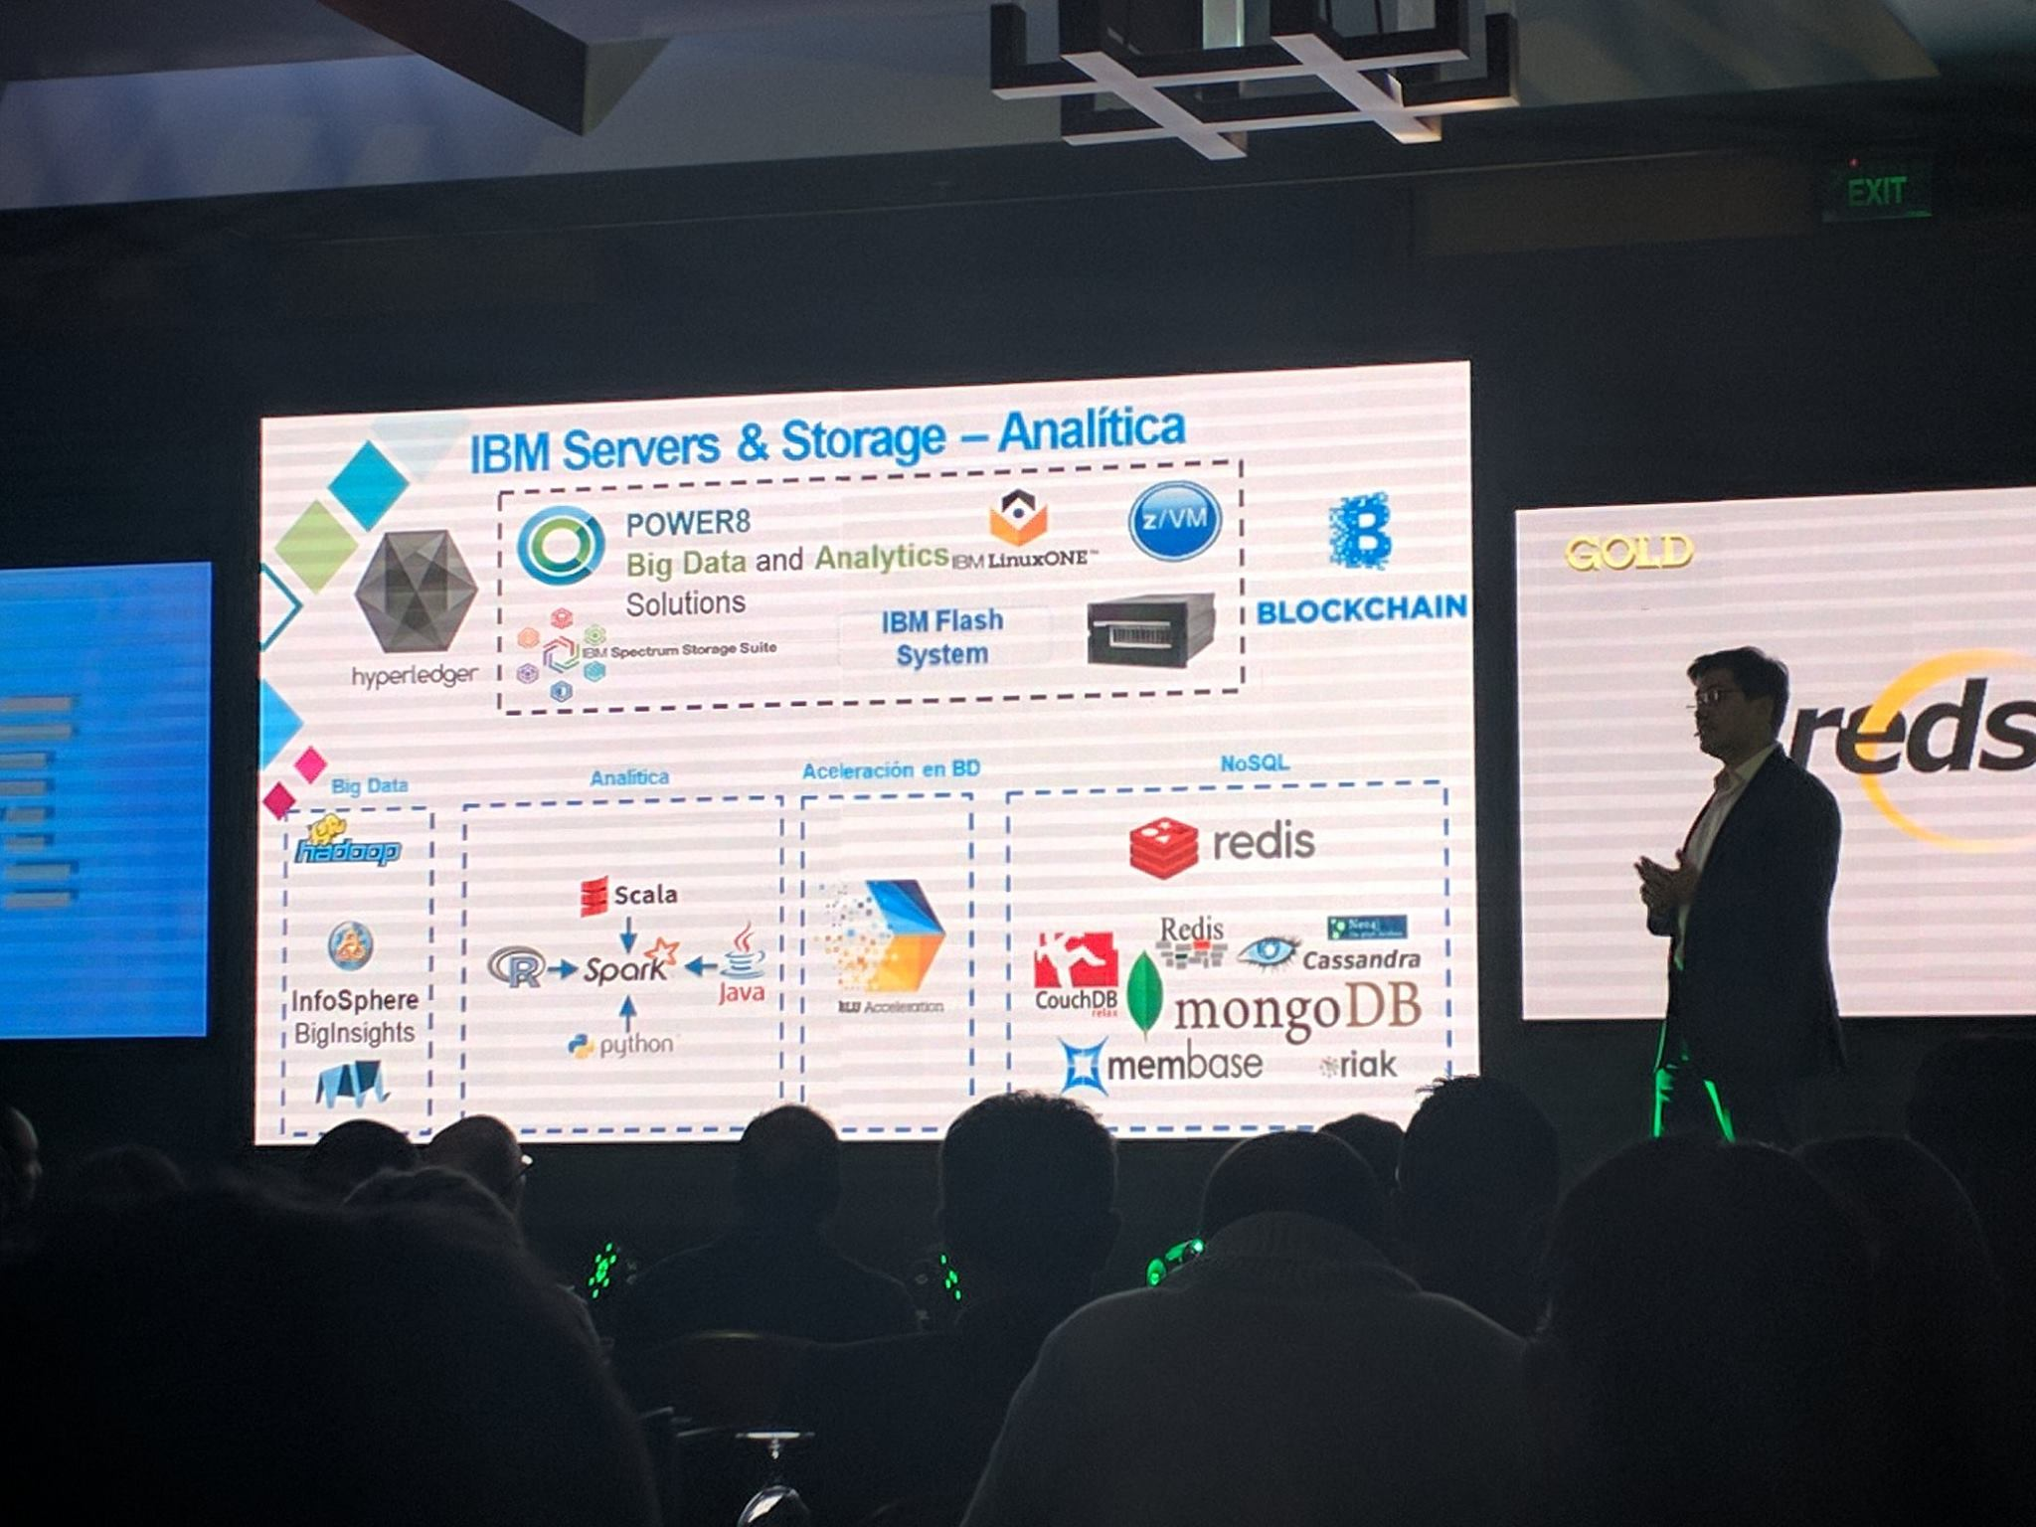
7. Big Data
Notes:
Cualquier crecimiento exponencial en la data ya sea de megas a teras ya considera como un insumo real para trabajar con big data

Slide 19
ETL Cycle
Validate data sources
Extract and merge join sources
Load data in the destination
Apply some kind of transformation in stage zone

Slide 20
Old process VS New process
-
- The process has some fails but it is stablest and if it works do not touch it.
- It decrease the performance
- Really, try to do it !
-We are going to prove that you are wrong.
- It's hard to maintain
- We will !
Don't ask them about the process, We will improve it ourselves.
Find out the best solution to accomplish business request

